Slide 1
PROJECT ON Smart Health Advisor
Submitted By:-
Shreya Gupta(10110402715)
Alka Tanwar(00510402715)
Rishabh Kumar(00110407216)
Pankaj Gupta(40310407216)

Slide 2
OBJECTIVE
We planned to develop a smart healthcare website to eliminate the travelling cost in visiting a doctor and reduces the time required to get the best treatment advise.

Slide 3
PROJECT DESCRIPTION
The Project “Smart Health Advisor” is aimed to provide an environment where individuals can see their health status and book the appointment.
It also provides the facility to users to search for hospitals in any location.
Unregistered users can calculate various health parameters like BMI,body fat, heart beat rate, total energy expenditure, etc.
Registered users can book for the appointment.

Slide 4
FEATURES
User friendly
Easily accessible
Provides Google map service.
Common platform for doctor/clinic appointment.

Slide 5
SOFTWARE REQUIREMENTS
Frontend:
HTML
CSS
Backend:
PHP/MY SQL
JavaScript
Software Used:
Apache (XAMPP) Server
Sublime Editor/Notepad++

Slide 6
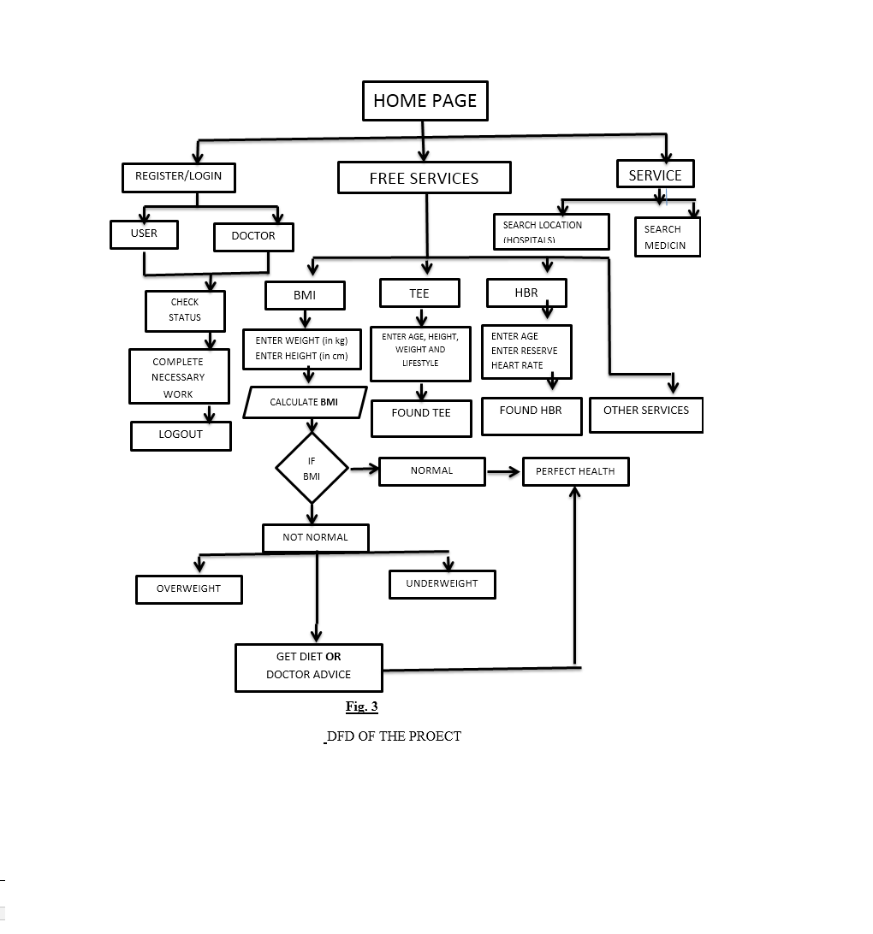
DATA FLOW DIAGRAM

Slide 7
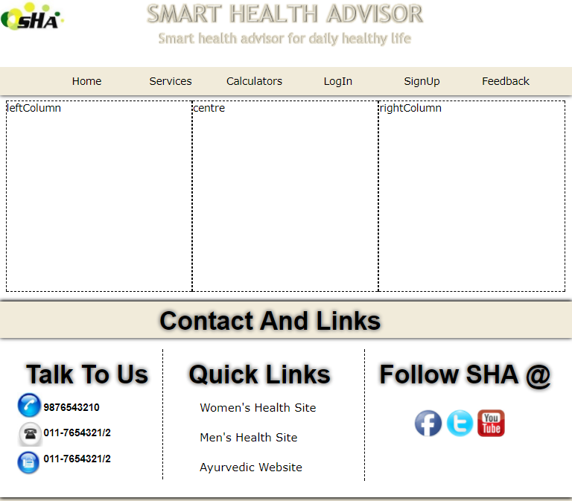
BASIC LAYOUT

Slide 8

HOME PAGE

Slide 9
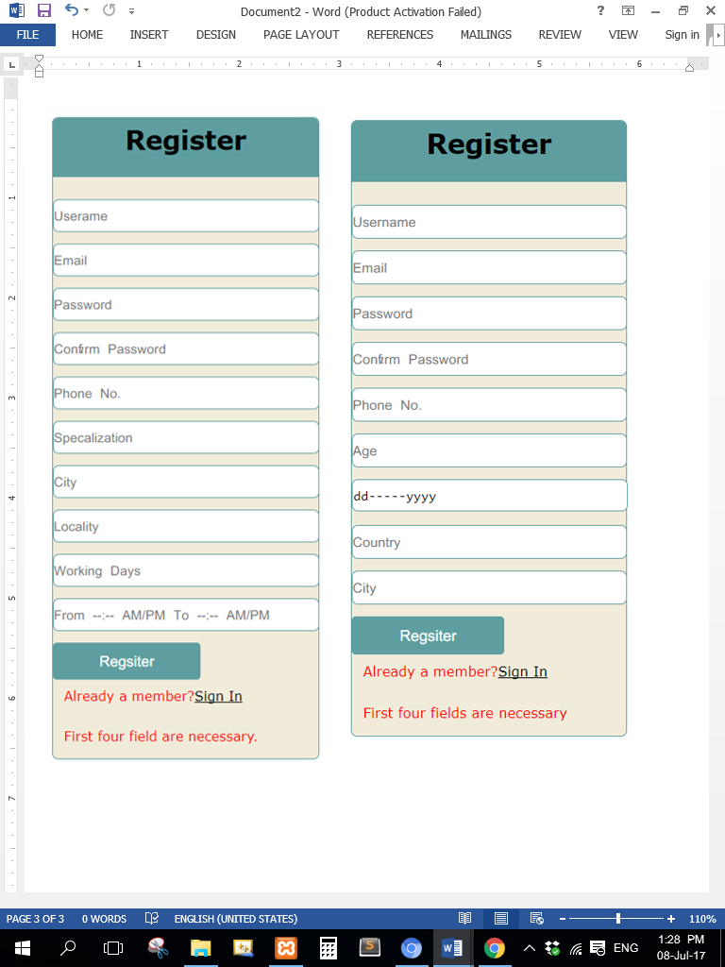
REGISTRATION PAGE

Slide 10
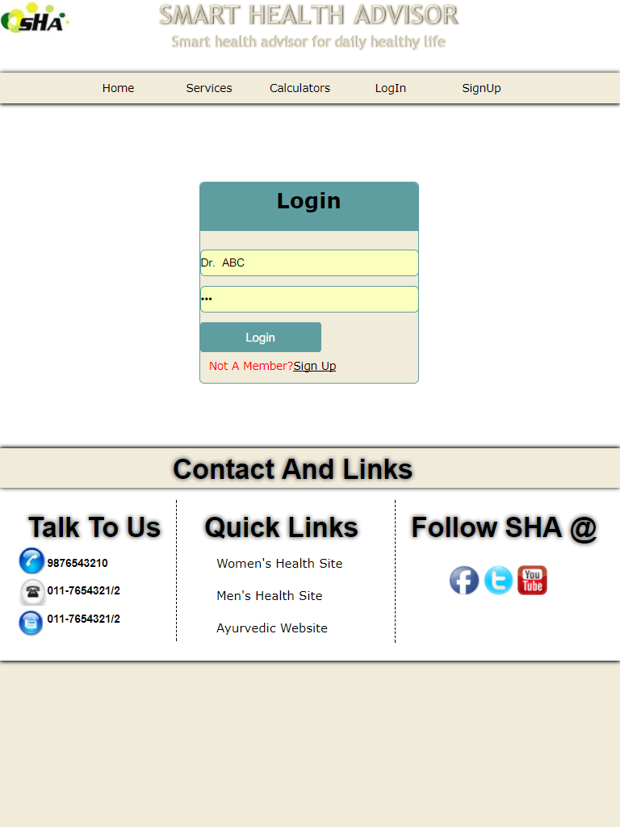
LOGIN PAGE

Slide 11
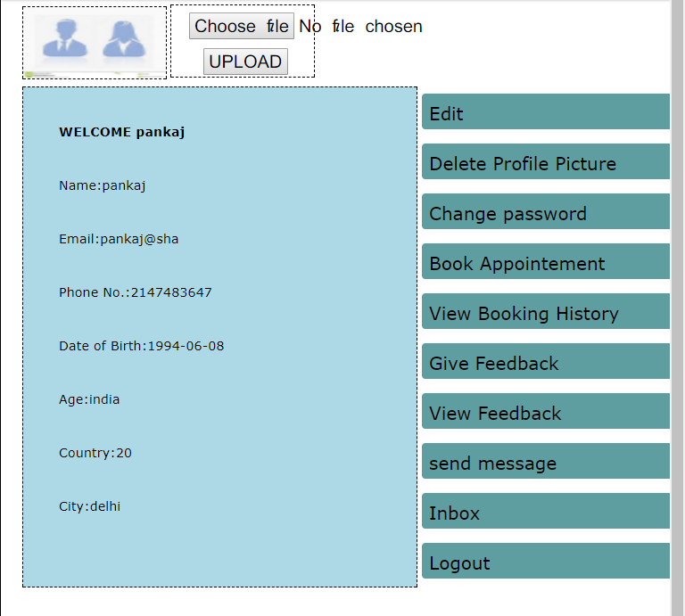
USER PROFILE

Slide 12
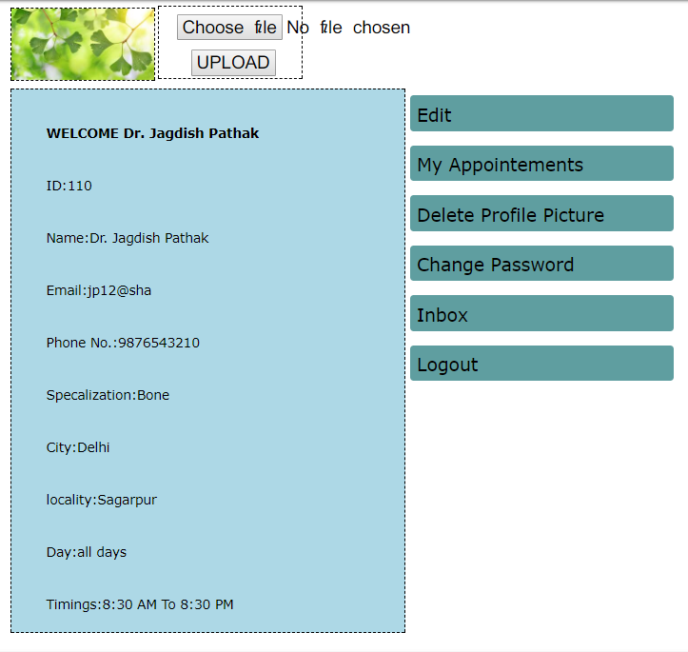
DOCTOR PROFILE

Slide 13
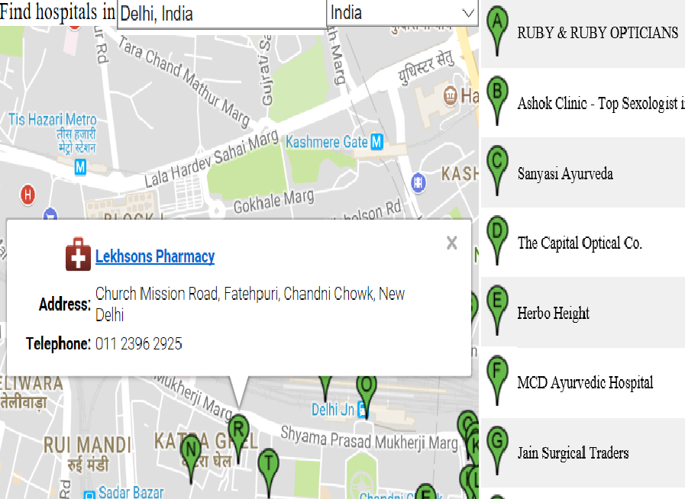
SEARCH HOSPITALS

Slide 14
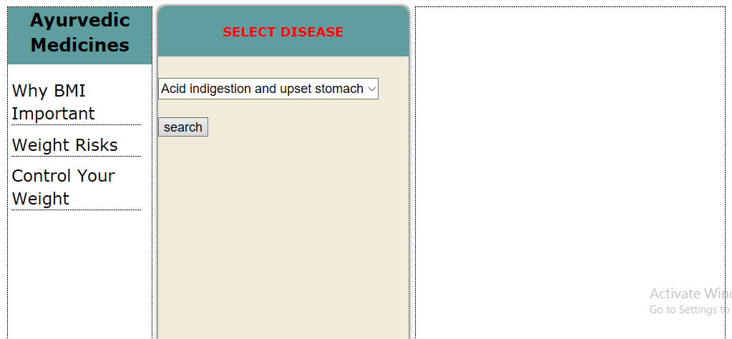
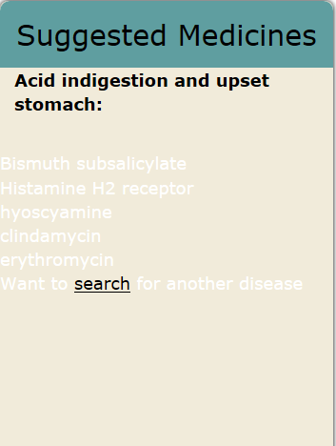
SEARCH MEDICINES

Slide 15
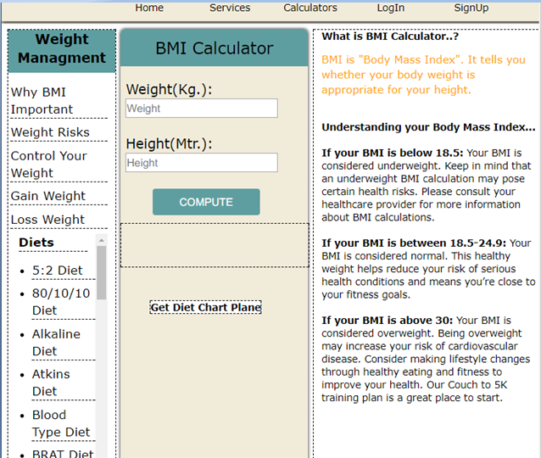
BMI CALCULATOR

Slide 16
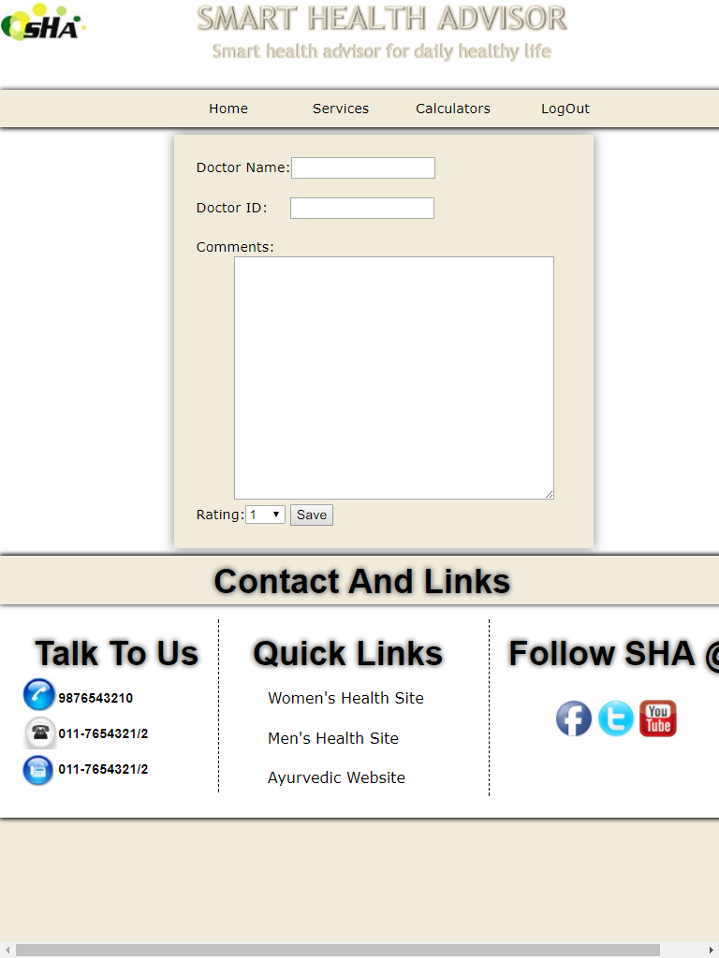
FEEDBACK

Slide 17
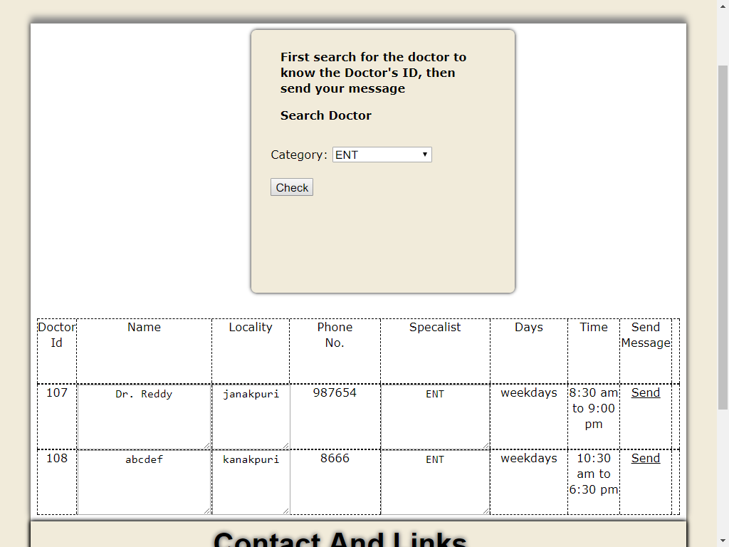
SEARCH DOCTOR

Slide 18
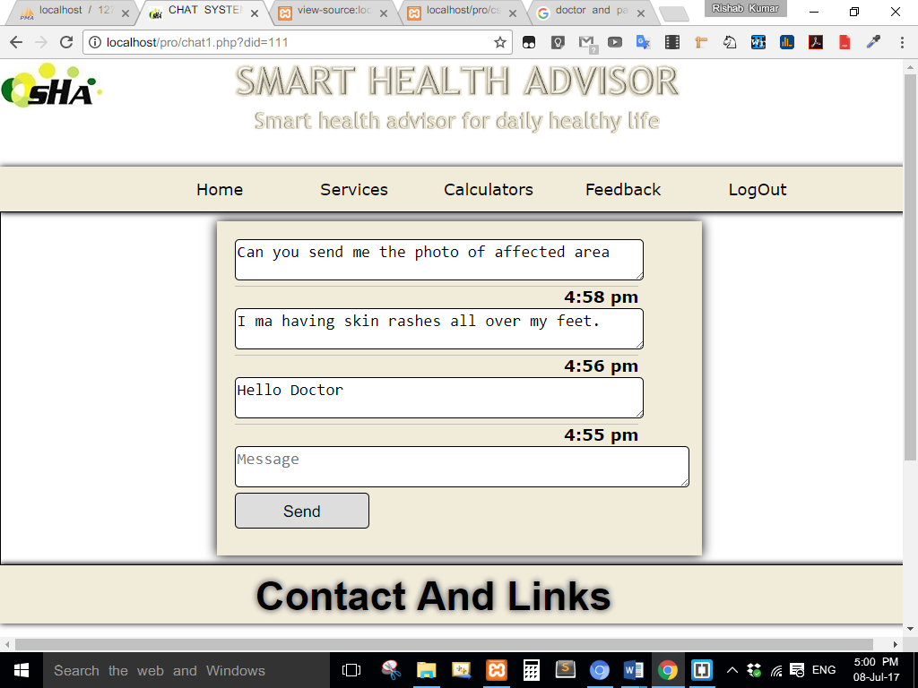
SEND MESSAGE

Slide 19
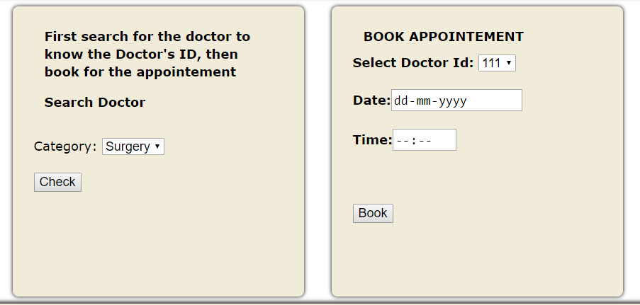
BOOK APPOINTMENT

Slide 20
Thank You

